Slide 1
Employee Data Analysis using Excel
STUDENT NAME: SAKTHIVEL K
REGISTER NO : 312211666
NM ID:60E445E8963E4F2B4084B4B2E5C9A5C7
DEPARTMENT: COMMERCE GENERAL
COLLEGE: THIRUTHANGAL NADAR COLLEGE

Slide 2
PROJECT TITLE
Employee Performance Analysis using Excel

Slide 3


AGENDA
Problem Statement
Project Overview
End Users
Our Solution and Proposition
Dataset Description
Modelling Approach
Results and Discussion
Conclusion
3/21/2024 Annual Review

Slide 4

PROBLEM STATEMENT
This analysis will help uncover patterns and insights that can inform better decision-making regarding workforce management and development.

Slide 5

PROJECT OVERVIEW
This project aims to analyze workforce data to uncover trends in performance, retention and satisfaction. By analyzing various employee metrics such as demographics, performance reviews tenure and turnover.
.

Slide 6





WHO ARE THE END USERS?

Slide 7

OUR SOLUTION AND ITS VALUE PROPOSITION
Conditional formatting -Highlight blanks
Filter -Remove blanks
Formula -Performance analysis
Pivot table -Summarize information
Graph –Data visualization

Slide 8
Dataset Description
A collection of data
A dataset is a structured collection of data that is organized and stored for processing or analysis. It can include many different types of data,
A research study
A dataset can also refer to a collection of raw statistics and information generated by a research study. Datasets produced by non-profit organizations or government agencies can usually be downloaded for free.
A job description
A job description dataset can include information about a job's role, job portal, job description, benefits, skills, responsibilities, company name, and company profile

Slide 9

THE "WOW" IN OUR SOLUTION
Employees
Scorecards can help managers track employee performance over time, and identify areas where employees may need training or development. They can also help managers identify employees who are meeting or exceeding expectations, and those who may need more help. Scorecards can be tailored to fit the needs of each company and can be used for any type of employee, from hourly workers to managers.
3/21/2024 Annual Review
‹#›

Slide 10
 | COUNTA of EmpID | COUNTA of Performance Score
 | 0 | 0
Aaden | 1 | 1
Aaliyah | 1 | 1
Aarav | 1 | 1
Aaron | 2 | 2
Abagail | 3 | 3
Abbigail | 3 | 3
Abby | 3 | 3
Abdellah | 1 | 1
Abdiel | 1 | 1
Abdullah | 4 | 4
Abel | 4 | 4
Abigayle | 1 | 1
Abram | 1 | 1
Abril | 2 | 2

Slide 11
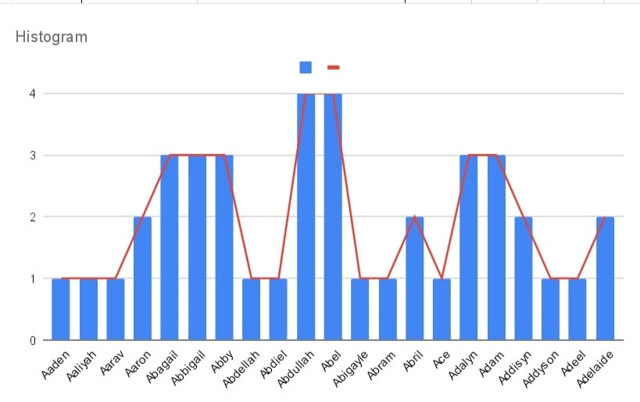
MODELLING
‹#›

Slide 12
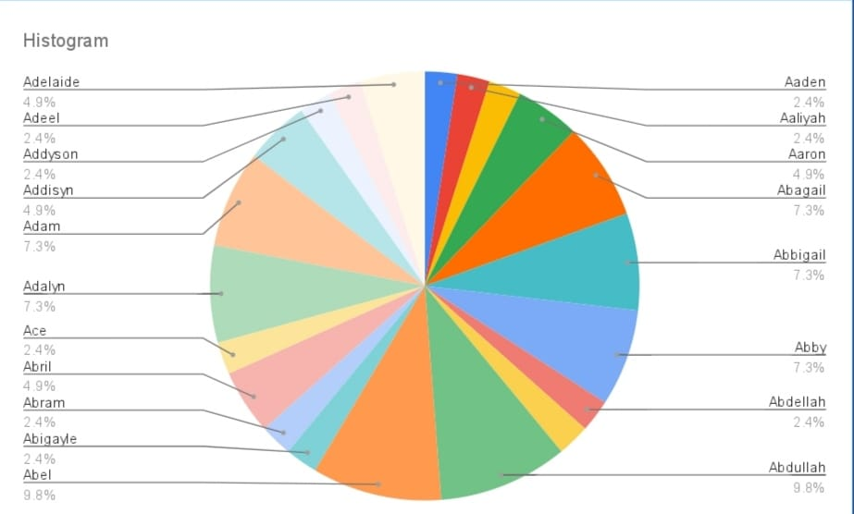
RESULT
‹#›

Slide 13
CONCLUSION
The study reveals that the performances of the Executives are being evaluated through KPA system.
The KPA system and PCCS card are playing vital role in evaluation of the performance without any bias.
▸ Marks/ Grading being done at the year end based on the actual performance against the committed task at the beginning of the year.
Based on the Marks/ Grade obtained, the Incentives and Promotions are awarded.
▸ At the year end actual performance of the individual is first self evaluated and submitted to the reporting officers for awarding marks which are subsequently endorsed/modified by the reviewing officers.

